Slide 1
Persistent Identifiers for Research
Natasha Simons
Snr Data Management Specialist
Brisbane ResBaz workshop 8 Feb 2017

Slide 2
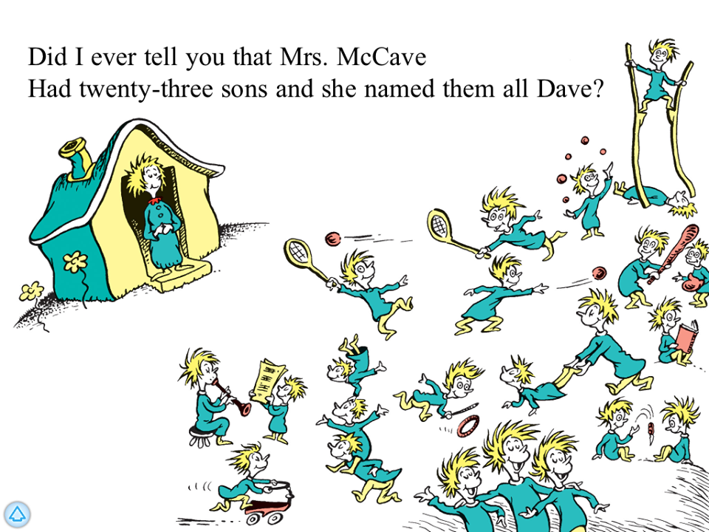

Slide 3


Slide 4

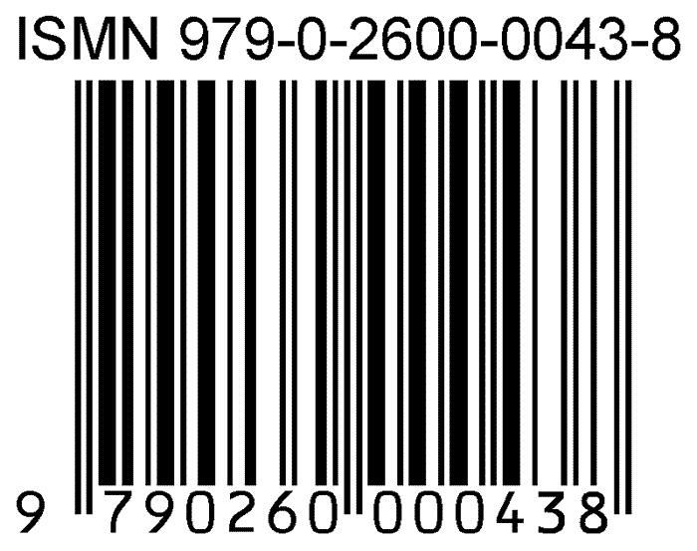
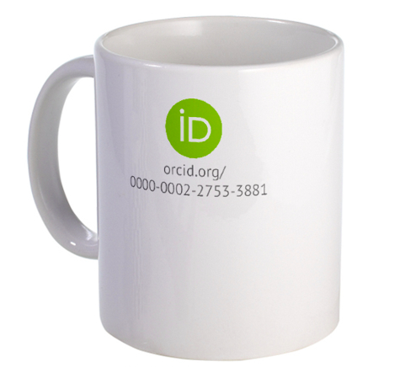


Slide 5
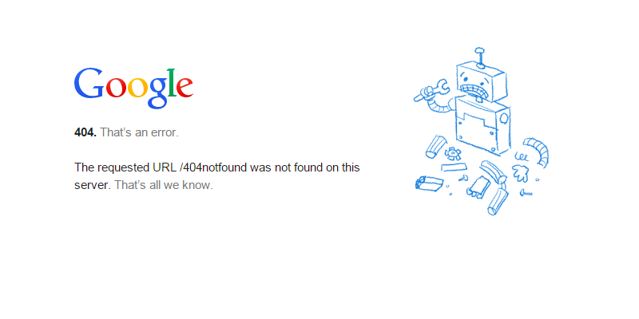

Slide 6
Digital Object Identifiers (DOIs)
10.4225/01/4F3DB08617645

Slide 7
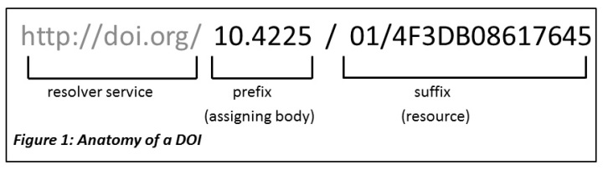

Slide 8
10.1045/may2012-simons
http://doi.org/10.1045/may2012-simons

Slide 9
Citing Online Business Resources using APA Style
Holland, C. P. (1995). Cooperative supply chain management: The impact of interorganizational information systems. The Journal of Strategic Information Systems, 4(2), 117-133. doi:10.1016/0963-8687(95)80020-Q

Slide 10
How can DOIs help you?
Improves visibility of your research: easier to link to; can confidently be cited
Facilitates access to your research: people can click on the link to open your publication, report or dataset
Enables better metrics for your research: DOIs are much easier to track by citation algorithms then a non-DOI citation.
Enables nice linking between research objects especially publications and data (an increasing requirement of journal publishers).

Slide 11
DOIs for data
A condition of publication in a Nature journal is that authors are required to make materials, data, code, and associated protocols promptly available to readers without undue qualifications.
http://www.nature.com/authors/policies/availability.html

Slide 12
DOIs for data
http://datadryad.org/resource/doi:10.5061/dryad.fc74k

Slide 13


DOI Registration Agencies

Slide 14
Hands on
Find information about this DOI:
10.4225/08/5858219e78f9a
What type of research output does this DOI point to?
What is the organisation associated with this DOI?
Can you get to the full text from the DOI?
Now search for the same DOI in DataCite search: https://search.datacite.org/
How do you cite it in Vancouver style?
Who issued the DOI?
Finally, go to DataCite stats: https://stats.datacite.org/
For the Australian National Data Service, resolutions by month, what was the most clicked on DOI for November 2016? How many times was the DOI clicked on for that same month?

Slide 15
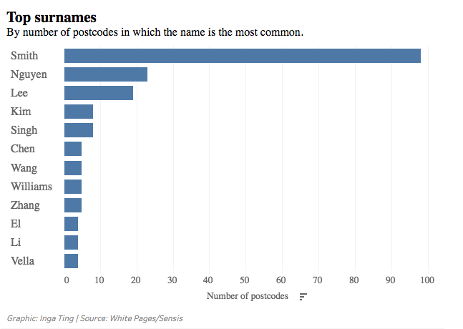
Sydney suburbs – August 2016
http://www.smh.com.au/nsw/new-data-shows-top-surnames-by-sydney-suburb-20160805-gqm56v.html

Slide 16
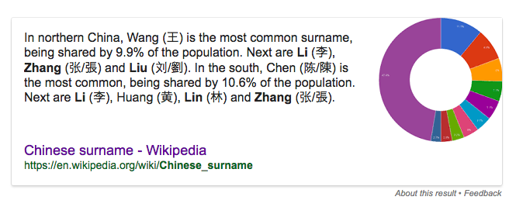

Slide 17
Name problems!
David Wright
D Wight
DA Wright
Dr D Wight
D Right

Slide 18
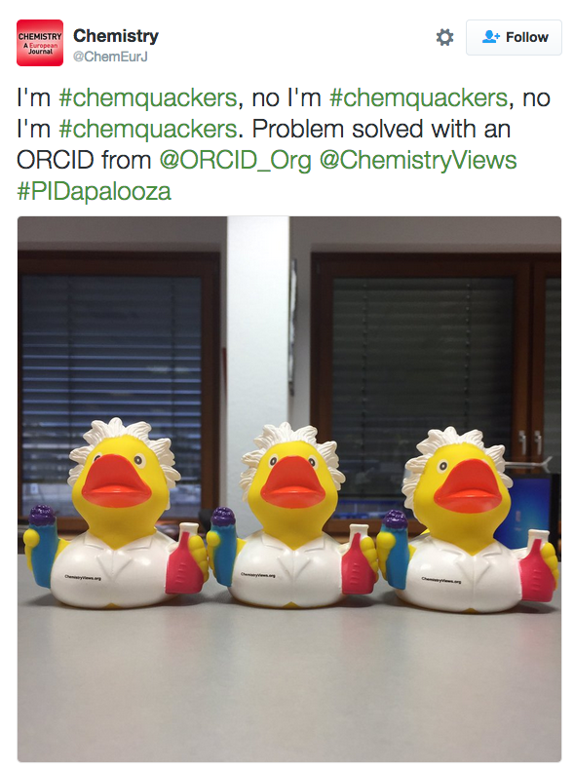


Slide 19
Peter Doherty
https://orcid.org/0000-0002-5028-3489

Slide 20
How can ORCID help you?
Distinguishes you from other researchers
Links all your work so you can get credit for all your work
Save time and effort: enter once, use often
Comply with publisher, funder and institutional requirements

Slide 21
Hands on
Create or enhance your ORCID iD
Go via you institution or go to https://orcid.org/ and click ‘sign in’

Slide 22
Example: create Impact Story using ORCID
https://impactstory.org/

Slide 23
Natasha Simons
ANDS is supported by the Australian Government through the National Collaborative Research Infrastructure Strategy Program. Monash University leads the partnership with the Australian National University and CSIRO.
With the exception of logos, third party images or where otherwise indicated, this work is licensed under the Creative Commons Australia Attribution 3.0 Licence.
@n_simons
Natasha.simons@ands.org.au

